Slide 1
Test Data Builders
Phil Pursglove

Slide 2
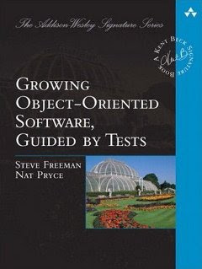
GOOS
Notes:
Didn’t get a lot out of it, need to read again

Slide 3
The Problem
Brittle code
Intention can be lost
Notes:
As code evolves and grows, test code that initialises your object can become brittle and need regular changes
As ctors become complex, the intention of a test can be lost in the noise

Slide 4
Solutions
Object Mothers
A helper for producing known sets of test data
Can still be brittle
Builder
Flexible
Can evolve side-by-side with your object
Fluent
Notes:
Eliminate the irrelevant, amplify the essential

Slide 5
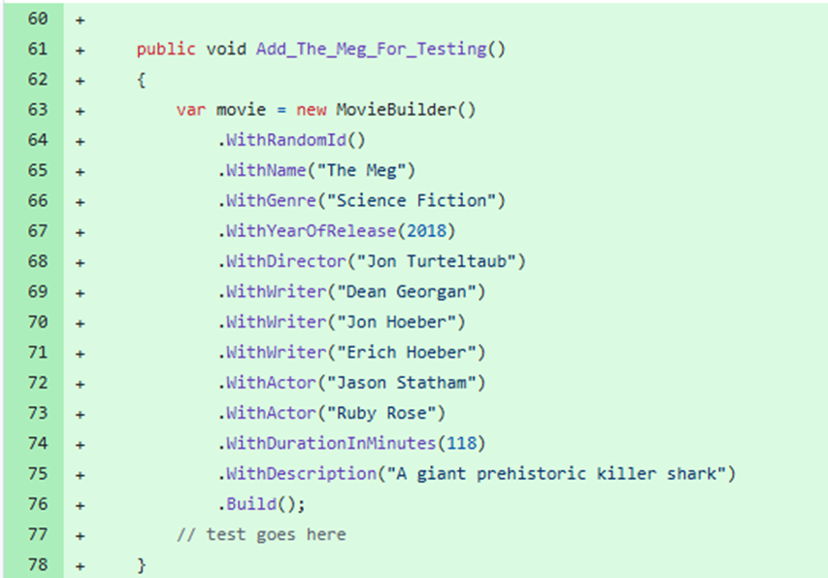
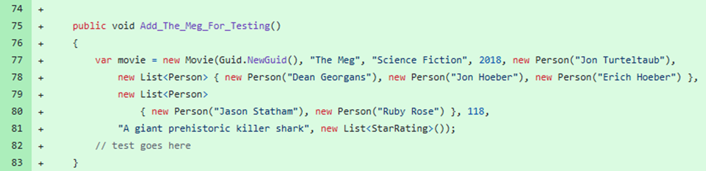
PRs

Slide 6
“Any fool can write code that a computer can understand. Good programmers write code that humans can understand.”
Martin Fowler

Slide 7
References
Growing Object-Oriented Software Guided By Tests Nat Pryce, Steve Freeman
Nat Pryce’s original article http://www.natpryce.com/articles/000714.html
Mark Seemann https://blog.ploeh.dk/2017/08/14/from-test-data-builders-to-the-identity-functor/
Steve Smith https://ardalis.com/improve-tests-with-the-builder-pattern-for-test-data/
https://tinyurl.com/tdbpp

